Slide 1
Graph and Trees

Slide 2
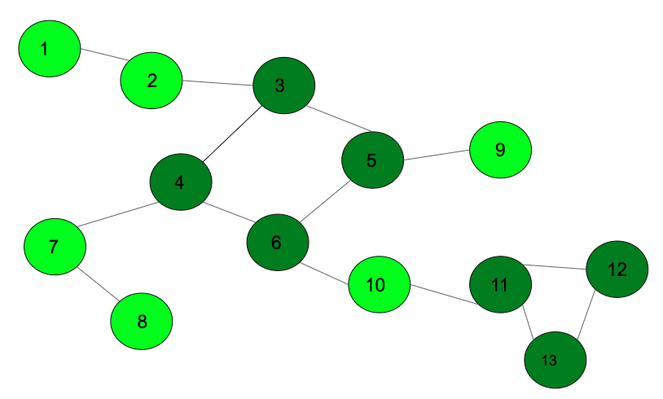
Graphs???
Graphs are non-linear data structures that are used to represent the relationships between various entities.

Slide 3
Real life examples………
Geography of the country: A country has various cities connected by roads. This type of information can be represented by graphs.
Network topology: The information like how computers are connected in a network, and how should the data be transferred between two computers can be represented by graphs.

Slide 4
Formal definition
A graph G can be defined as a pair (V,E), where V is a set of vertices, and E is a set of edges between the vertices E ⊆ {(u,v) | u, v ∈ V}.

Slide 5
Types???
CONNECTED/UNCONNECTED GRAPH
CYCLIC/ACYCLIC GRAPH
DIRECTED/UNDIRECTED GRAPH
WEIGHTED/UNWEIGHTED GRAPH
BIPARTITE GRAPH
SIMPLE GRAPH
DENSE/SPARSE GRAPH

Slide 6
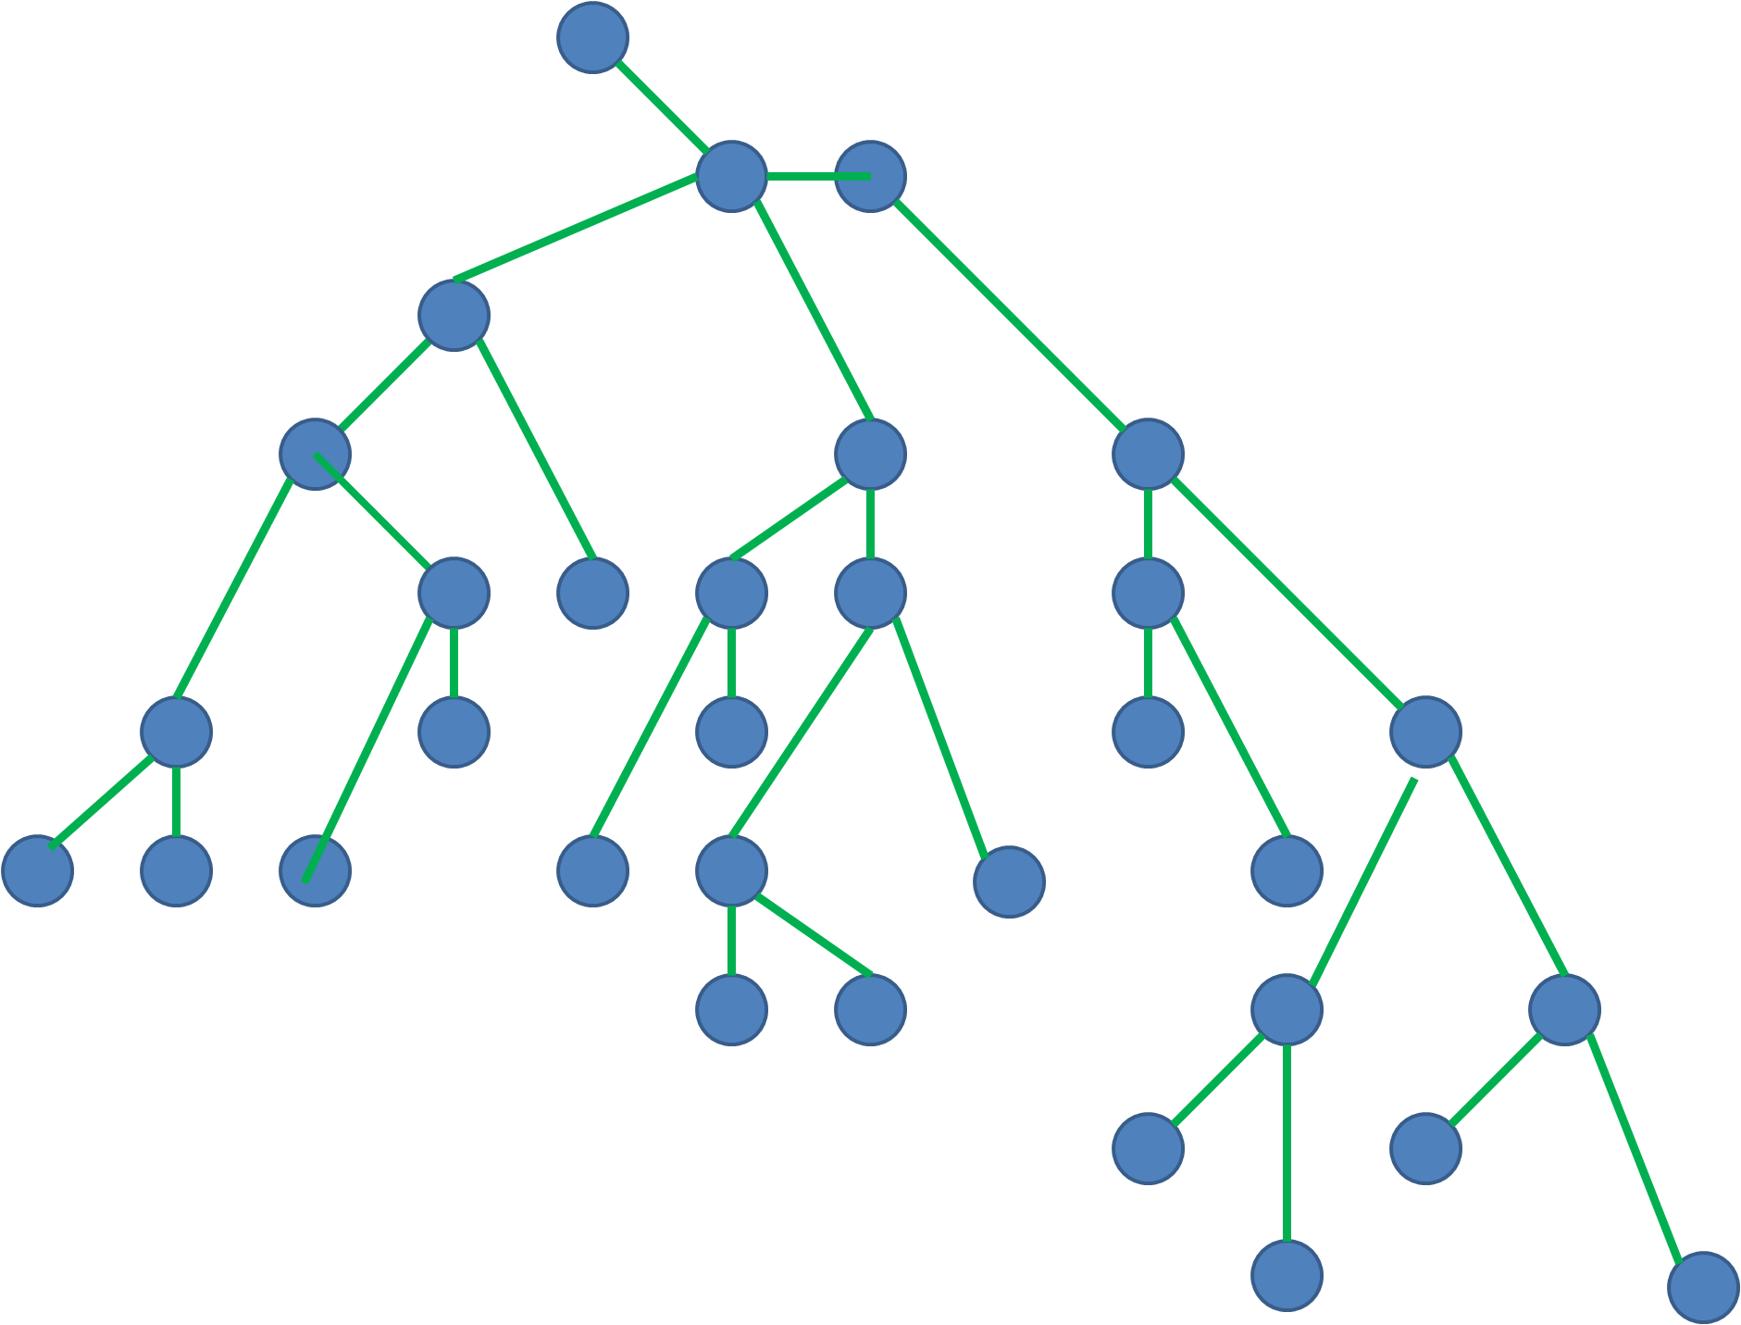
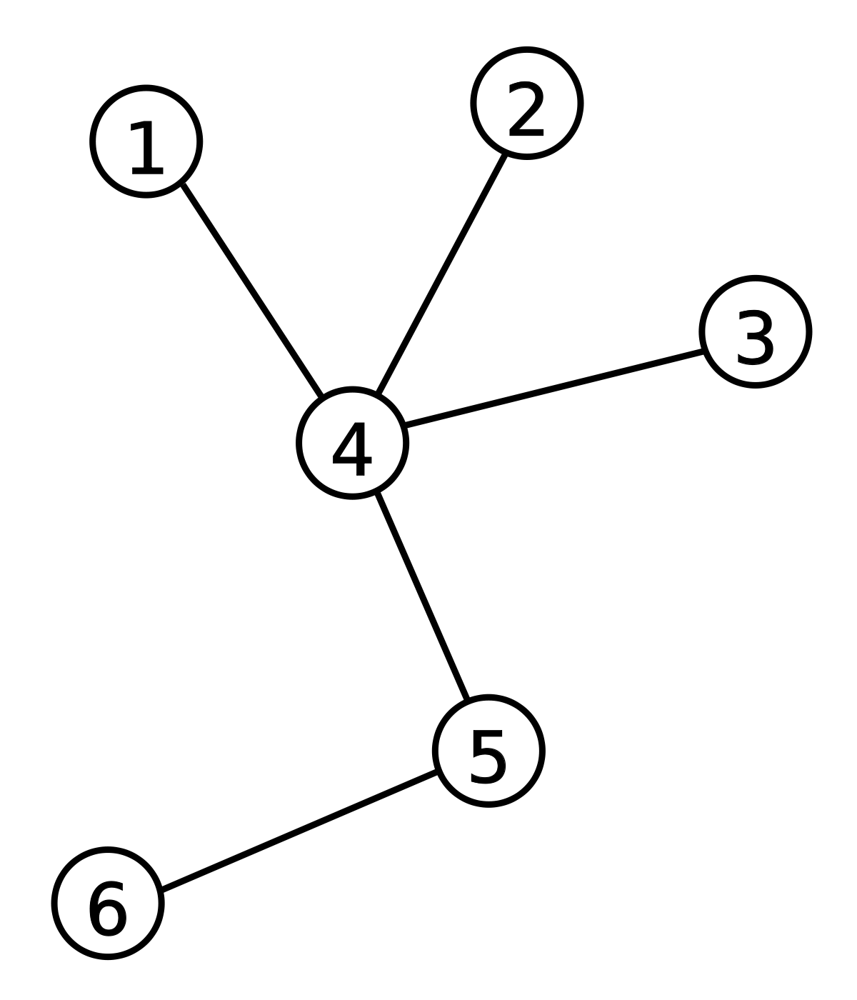
Trees???
Trees are nothing but acyclic connected graphs. Some of the
properties of trees include:
There are N-1 edges on a tree if the number of nodes = N.
A tree is acyclic
It is connected.

Slide 7
Graph and trees in code??
The most trivial way to represent graphs is using an array/vector of edges (pair of nodes which it connects). This type of representation is mostly used to give input in CP sites.

Slide 8
CODE

Slide 9
Basic algorithms

Slide 10
DFS
Depth-first search (DFS) is an algorithm for traversing or searching tree or graph data structures. The algorithm starts at the root node (selecting some arbitrary node as the root node in the case of a graph) and explores as far as possible along each branch before backtracking.
Stacks are used for DFS.

Slide 11
CODE

Slide 12
BFS
The algorithm can be visualized as a fire originating from some node and spreading throughout the graph using the edges.
Queues are used for the same.

Slide 13
CODE

Slide 14
QUESTIONS…

Slide 15
Question - 1
Given a tree with N nodes each node numbered from 0 to N - 1. It is rooted at node 0. Each node has been assigned a value i.e., for node ‘x’ value is val[x]. Can you find the depth of the node with value ‘Y’?

Slide 16
BFS OR DFS??

Slide 17
CODE

Slide 18
Question - 2
Count number of subgraphs in a disconnected graph?

Slide 19
Let’s move to a bit tough question

Slide 20
Question - 3
Detect cycle in an undirected connected graph?
Here, cycle is a path from a certain node X to itself, such that the path contains at least 1 edge and no edge is repeated in the path.

Slide 21
Do we really need an algorithm for this question?

Slide 22
Now the graph need not be connected……… Then??

Slide 23
Can we use the previous trick??

Slide 24
Now, the graph is directed and need not be connected………

Slide 25
Solution: Topological sort or DFS with stack
Baad main padhenge………

Slide 26
LET’S INCREASE DIFFICULTY again

Slide 27
Question - 4 (Asked in oa)
There are N people numbered from 0 to N - 1. You are given given an array ‘A’ of pairs of size M. At ith second, A[i].first and A[i].second become friends.
If A and B are friends, B and C are friends, then A and C are also friends.
Determine the instant at which all the N people become friends.

Slide 28
Is your solution O(N^2) ???
Constraints:
1 <= N <= 1e5
1 <= M <= 1e5

Slide 29
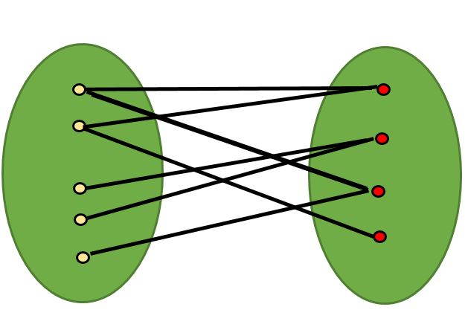
Bipartite graph
A Bipartite Graph is a graph whose vertices can be divided into two independent sets, U and V such that every edge (u, v) either connects a vertex from U to V or a vertex from V to U.

Slide 30
How to check whether a graph is bipartite?
DFS?

Slide 31
Question - 5
https://codeforces.com/group/hUywLYmr80/contest/383005/problem/A

Slide 32
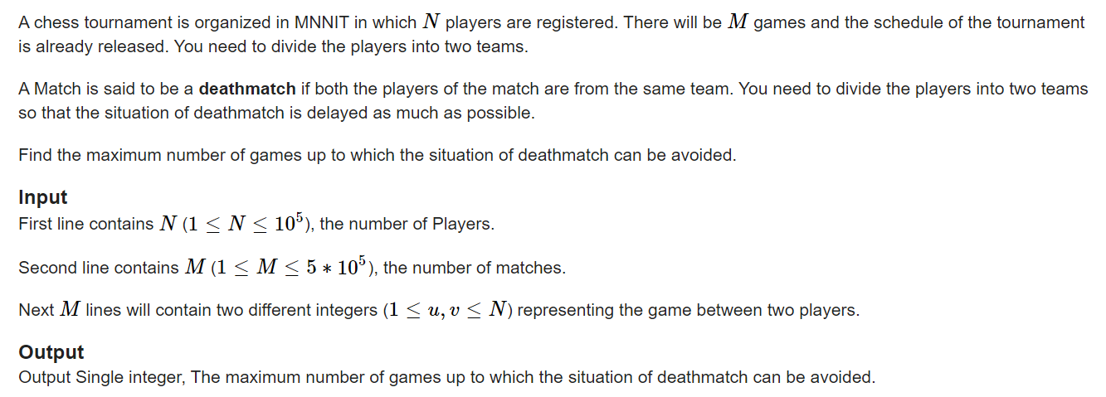
Cause of network issue, here’s the ss

Slide 33
